Slide 1
A Light Transport Framework for Lenslet Light Field Cameras
Chia-Kai Liang
Ravi Ramamoorthi
Lytro
UCSD
Notes:
Thanks Gordon
Hello everyone. Today I will present a new framework to analyze the light field cameras.
This work is done by me and professor Ravi Ramamoorthi of UCSD.

Slide 2
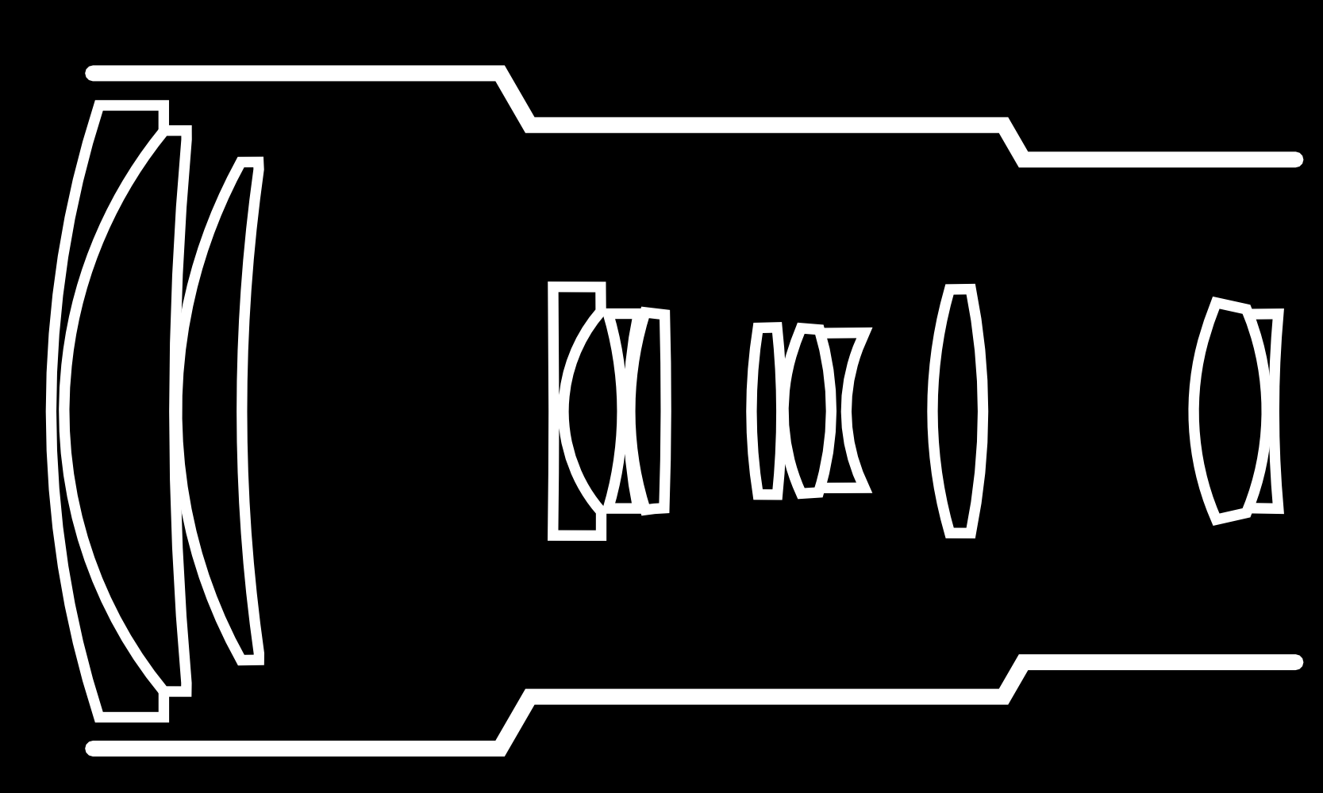
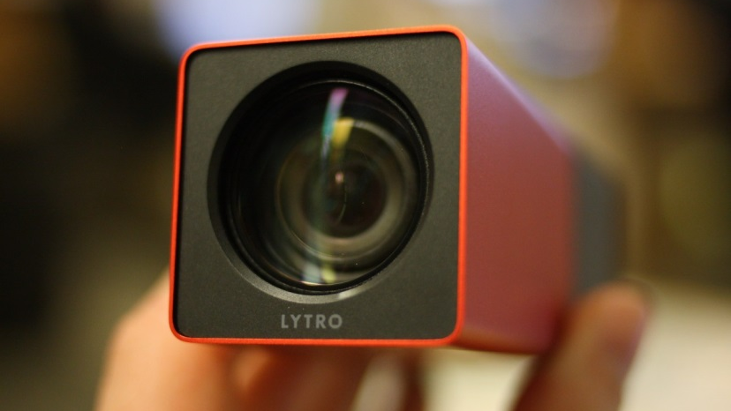
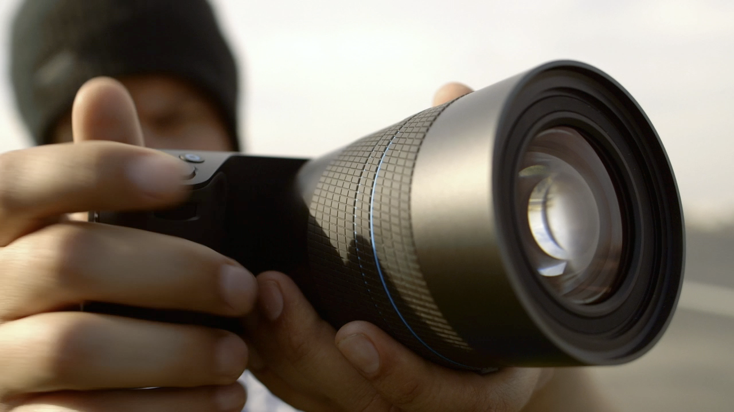
Main Lens
Lenslet/Microlens Array
Photosensor Array
(Lenslet-based) Light Field Camera
[Lippmann 1911, Wang and Adelson 1992, Ng et al 2005]
Notes:
Key message: What is a light field camera
The light field camera is constructed by a main lens, the sensor array, and an lenslet, or microlens array
It can capture both spatial and angular light field information and enable many exciting applications, for instance (cont)
Note: Change the sentence if we have to skip the first page

Slide 3
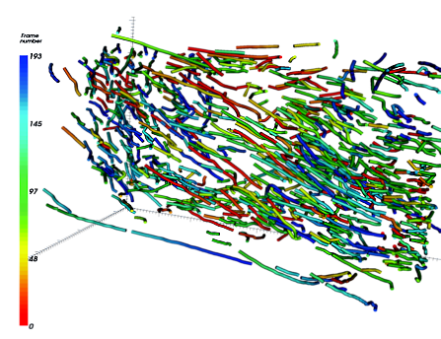
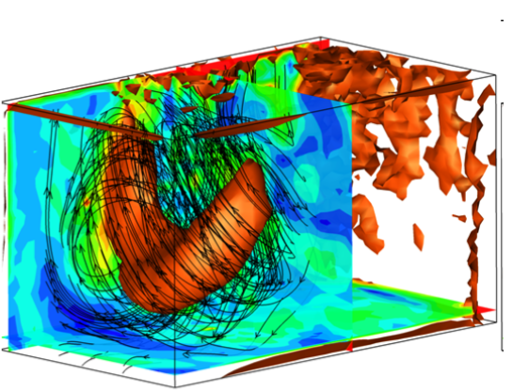
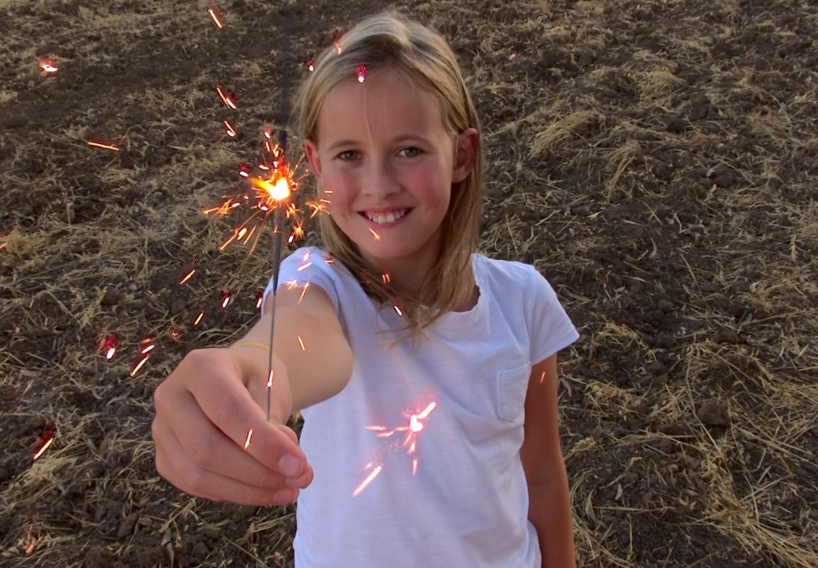
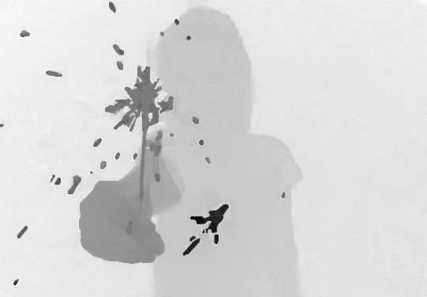
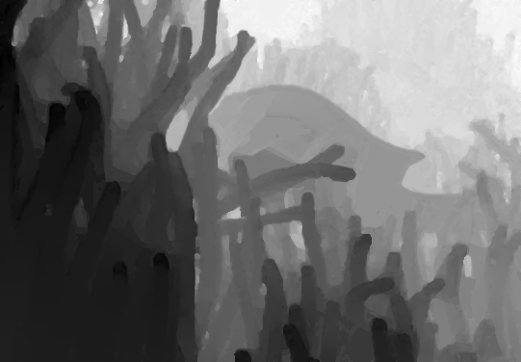
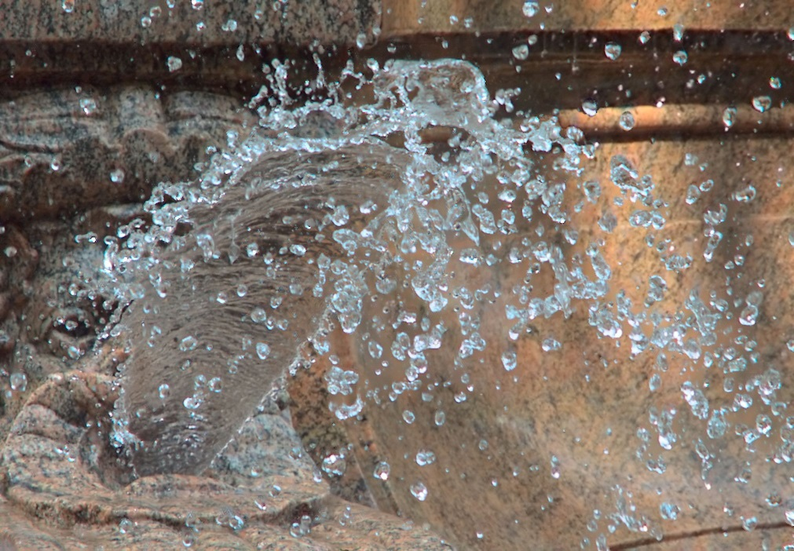
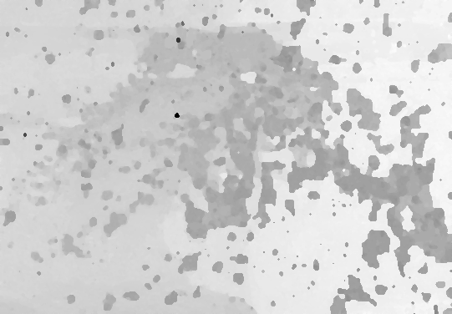
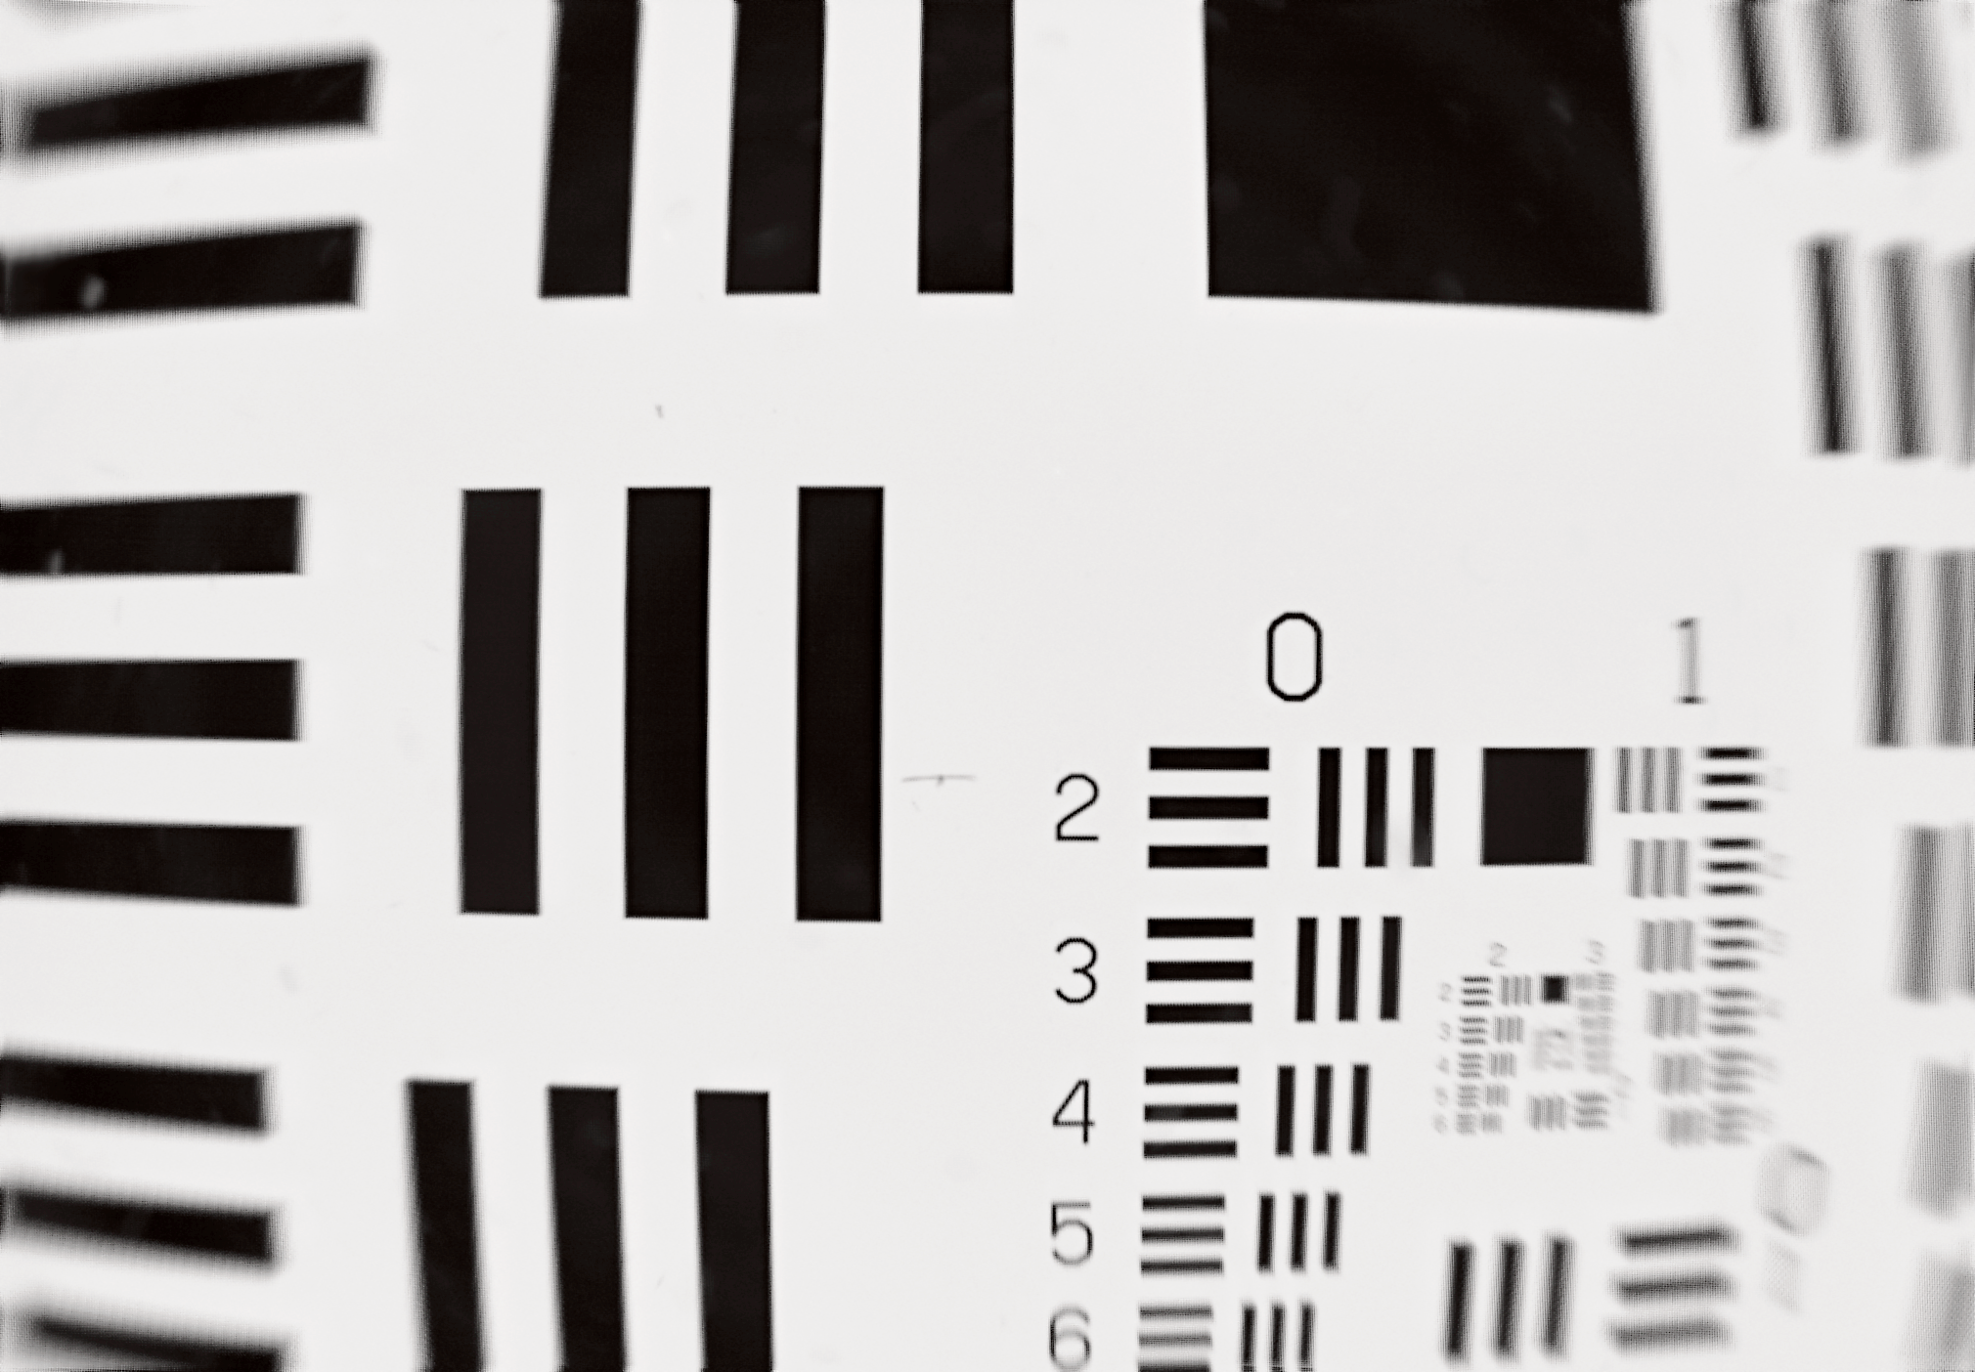
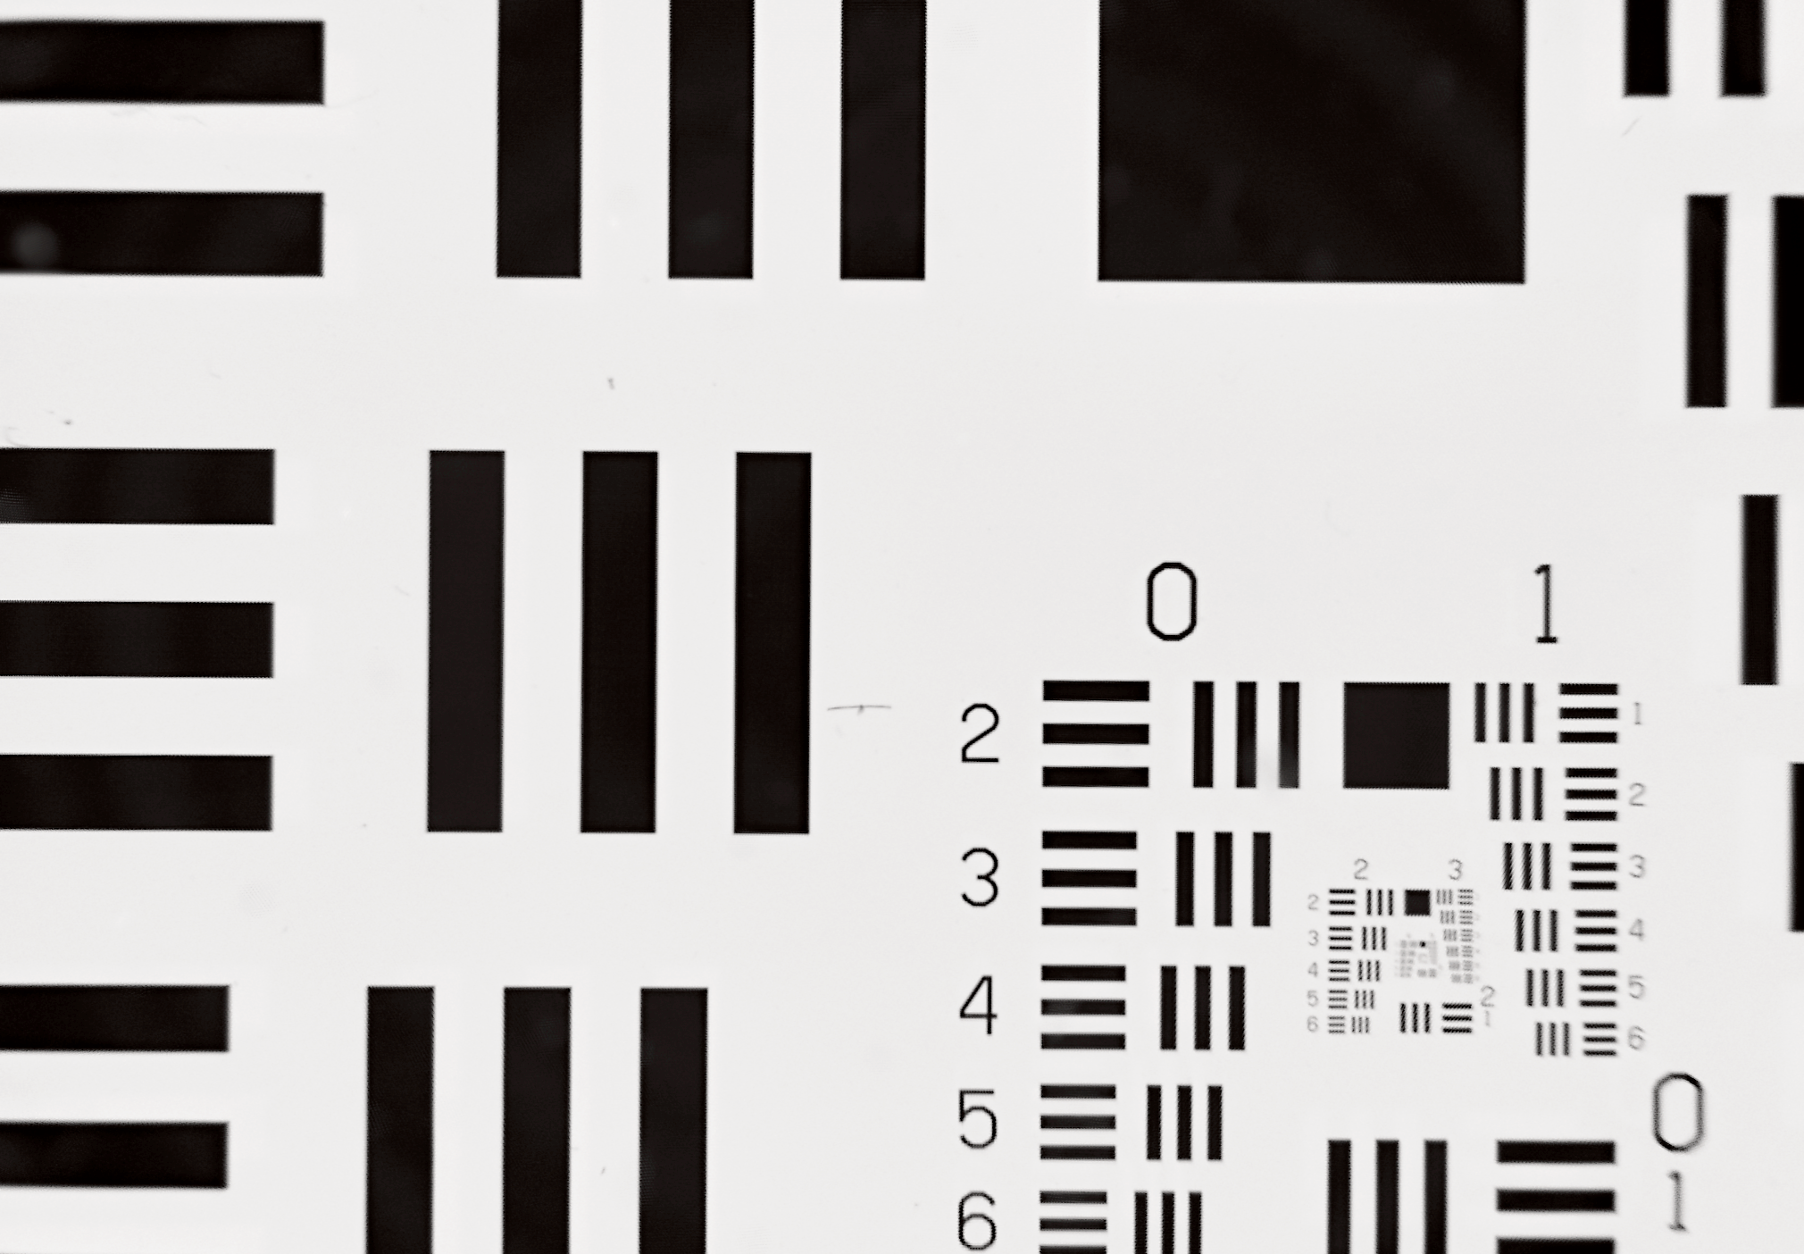
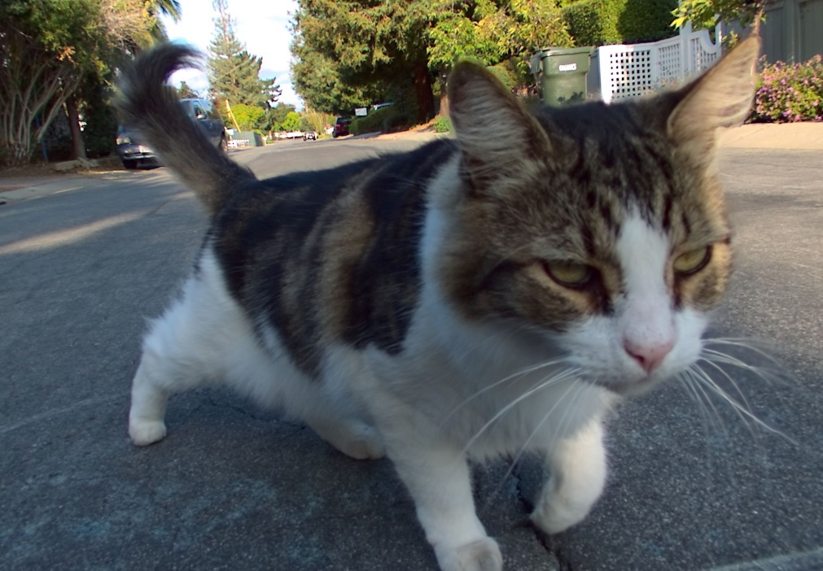
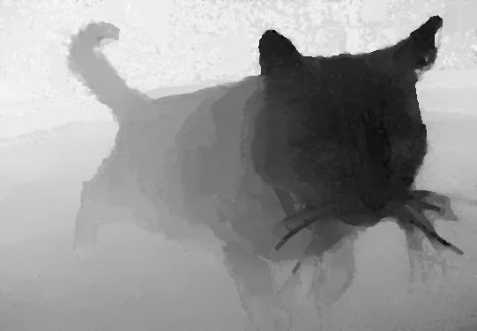
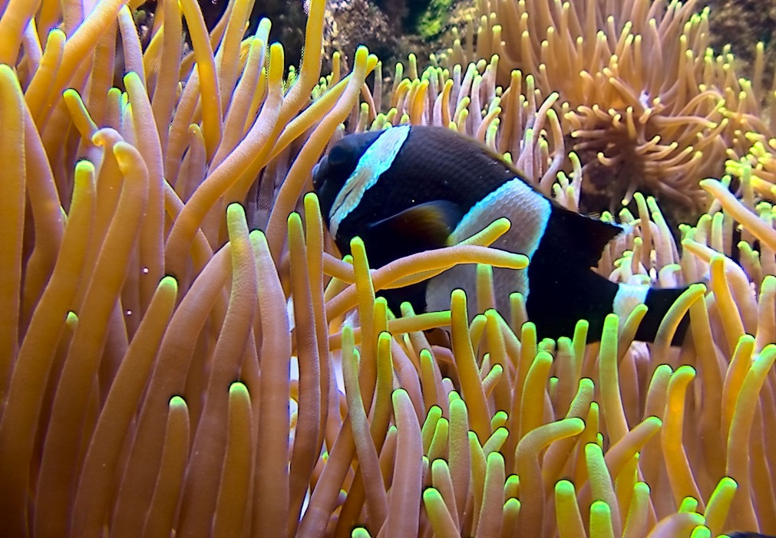
Post-Capture Adjustments
Volumetric Velocimetry
[Nonn et al 2012]
One-Shot Depth Sensing
Aberration Correction
[Ng 2006, Lytro ILLUM, Wei et al 2015]
Notes:
Key message: Applications of light field cameras
(cont) we can use it to change the capture setting and create the well-known refocus effects.
We can also analyze light field to extract the geometry of very challenging scenes, or even dynamics of fluid.
Finally, we can use the light field to correct the aberration distortion in the main lens.
(While the light field camera can enable these applications, it has a few problems. Here we list the top three)

Slide 4
Top Three Problems of Light Field Cameras
Low Resolution
Low Resolution
Low Resolution
LF camera research ~= Improving spatial resolution
Ng 2006; Veeraraghavan et al 2007; Liang et al 2008; Perez Nava and Luke 2009; Lumsdaine and Georgiev 2009; Perez and Luke 2009; Levin and Durand 2010; Georgiev et al 2011; Bishop and Favaro 2012, Wanner and Goldluecke 2012; Marwah et al 2013; Tambe et al 2013; Venkataraman et al 2013; Shroff and Berkener 2013; Broxton et al 2013; Wetzstein et al 2013; Cho et al 2013; Fiss et al 2014; Boominathan et al 2014; Wei et al 2015
Notes:
Key message: Low Resolution!
While the light field camera can enable these applications, it has a few problems. Here we list the top three:
The biggest problem is that the resolution is too low.
The second biggest problem is that the resolution is too low, and the third problem, is that the resolution is too low.
The study shows that the output resolution is a tiny fraction of the sensor resolution.
If you look back on the researches of the light field imaging in the last decade, it is more or less equivalent to a war for higher resolution, and the war has not ended yet.

Slide 5
Resolution Tradeoff
Conventional Camera
Notes:
Key message: The main problem of the light field camera
The reason for low output resolution is due to the tradeoff for the angular information.
In a convention camera, each photosensor would integrate all rays into independent pixel values.

Slide 6
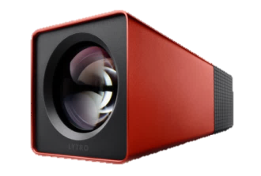
Resolution Tradeoff
Notes:
Key message: The main problem of the light field camera
However, in a light field camera, when the rays reach the lenslet, rays for different angles would be grouped separately and reach different pixels.
This gives us the directional information of the light field.

Slide 7
Resolution Tradeoff
Spatial resolution #sensor
Spatial resolution #lenslet
Angular resolution 1
Angular resolution #sensors / #lenslet
Notes:
Key message: The main problem of the light field camera
In this setting, the angular resolution is set by the number of sensors under a lenslet, and the spatial resolution would be the number of lenslets, which is usually much smaller than the pixel count.

Slide 8
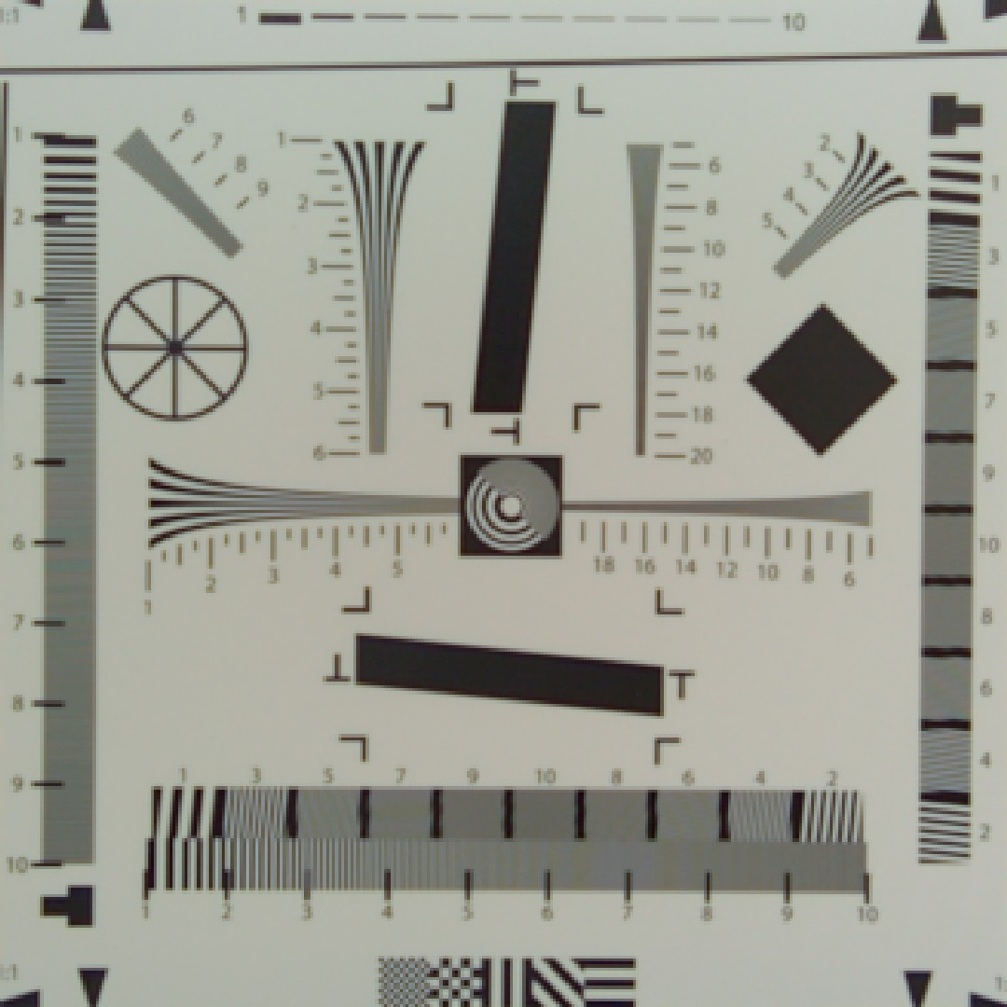
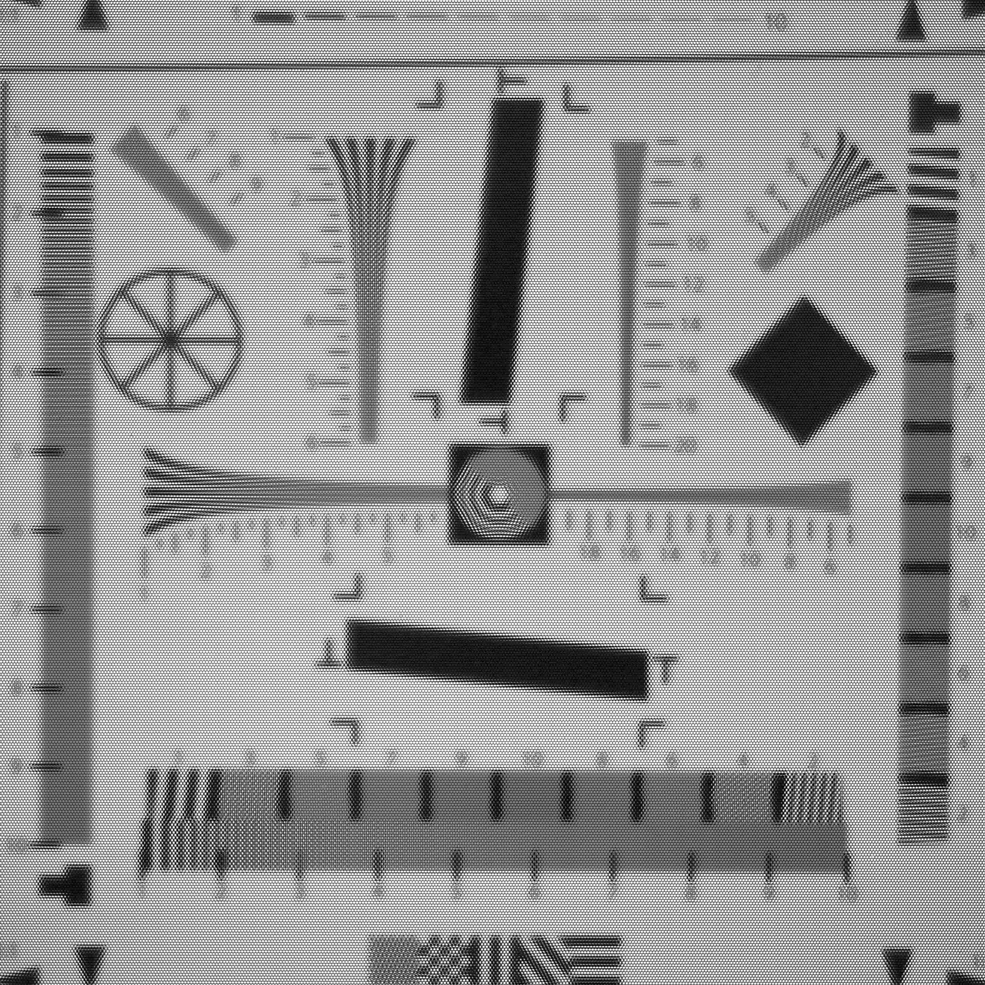
#lenslet: 328²
#sensor: 3280²
Incorrect Model
Notes:
Key message: Resolution from the current theory
For example, in the first Lytro light field camera, each lenslet covers roughly 100 pixels.
With the 11MP sensor, the resolution of the reconstructed image is only 0.1 mega pixel (or 100 kilo pixels), hardly enough for most applications.
However, we find that this is not an accurate claim. The resolution can be much higher than that (cont.)

Slide 9
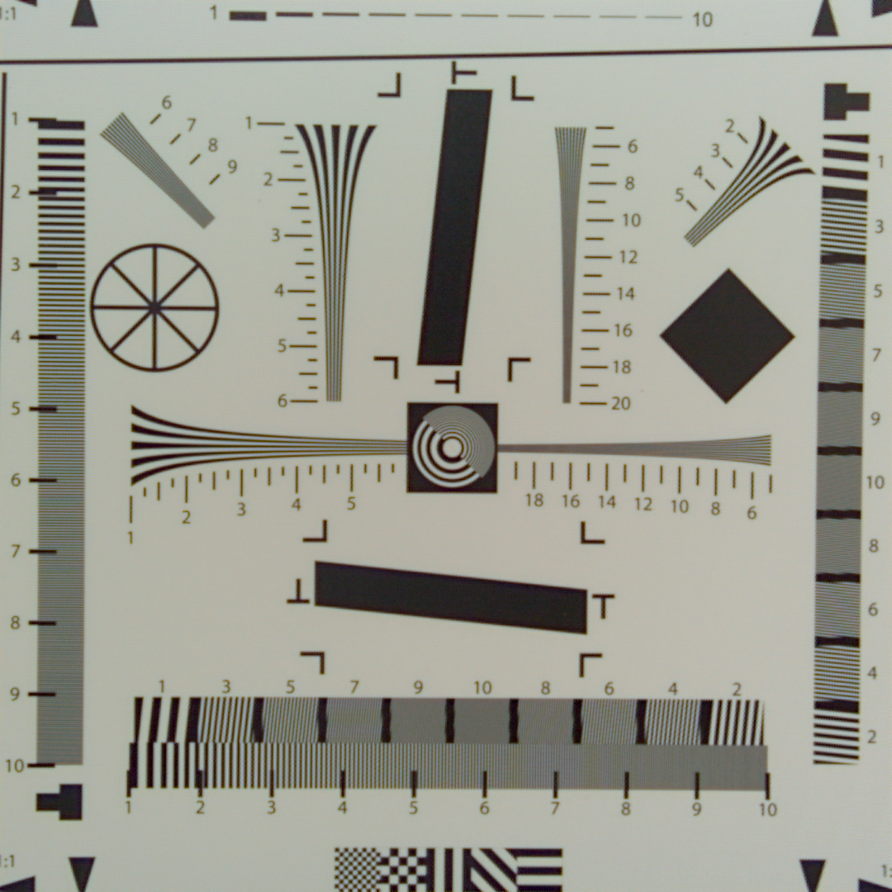
#lenslet: 328²
Our rendering: 1080²
Notes:
Key message: Resolution from the new theory
(cont.) like the one shown on the right. This image is generated from the same light field, without any deconvolution, texture synthesis, or other enhancement.

Slide 10
Our rendering: 1080²
A new theoretical framework
Why this is possible?
What is the real resolution?
Implications to light field imaging
Notes:
Key message: Resolution from the new theory
This is the main motivation of this work.
We will develop a new theoretic framework to explain: why this is possible?
What’s the real resolution of the LF camera?
And more importantly, what is the implication of our framework to light field imaging.
Note that because the original paper is a little bit lengthy. I will skip many details in the talk, and emphasize the key concepts.

Slide 11
Light Field of One Ray
u
u
x
x
Notes:
Key message: First concept
Let’s quickly review the concept of what is a light field and how to capture it.
For a light ray traveling in the space, it can be parameterized by the intersections with two parallel planes, and the coordinate of the interaction points construct a two dimensional space. We can map the ray to a point sample in this space.
In the following I will call the horizontal x domain as spatial domain and vertical u domain as angular domain.

Slide 12
Light Field of a Point
u
x
Notes:
Key message: Depth-dependent slope
For a point in the space emitting rays to all directions, the corresponding samples would fall on a straight line in this 2D space.

Slide 13
Light Field of Many Points
u
x
Notes:
Key message: Depth-dependent slope
For a scene with many points, each one would map to a straight line in the 2D space.
As we can see, the slope of the line would depend on the depth of the source point.
There is a strong correlation between the scene geometry and the structure of the light field signal, and this property has been utilized in many applications.

Slide 14
Light Field of Many Points
u
x
Notes:
Key message: (animation)

Slide 15
Light Field Spectrum
u
Ω_{u}
Fourier transform
x
Ω_{x}
Slope-Slice Duality
[Chai et al 2000, Ng 2005, Levin et al 2009]
Notes:
Key message: Depth-dependent slope in the frequency domain
This depth-slope relationship also holds in the frequency domain.
If we perform Fourier transform to the light field on the left, we will find that the spectrum on the right would be the combination of many slices passing through the origin. Each slice holds the energy of lines of certain slope, or objects at certain depth.
(cont, Therefore,…)

Slide 16
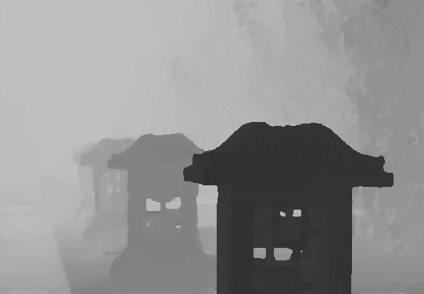
Spectrum Bandwidth
Far
Ω_{u}
Ω_{x}
Depth Map
Near
Notes:
Key message: Real example and show how the spectrum is limited by the depth range
Therefore, for a scene with a large depth range, its light field spectrum would be the combination of many slices,
and appear like a double wedge, as shown on the right.
The support of the wedge is defined by the depth of the nearest object and the farthest one.
(cont, the goal of the light field camera…)

Slide 17
Light Field Sampling
Ω_{u}
Ω_{x}
Notes:
Key message: (animation)

Slide 18
Light Field Sampling
Ω_{u}
Angular sampling rate
(#lenslet/#sensor)
Ω_{x}
Spatial sampling rate
(1/#lenslet)
Notes:
Key message: Light field sampling
The goal of the light field camera, is to faithfully sample the light field so it can be reconstructed later.
In the frequency domain, the sampling process would create an impulse array along both dimensions.
Unfortunately, at the current technology, the spatial and angular sampling rate cannot be very high, and thus the spacing between the impulses is quite limited.

Slide 19
Light Field Sampling
Strong Aliasing ☹
Notes:
Key message: Aliasing
The sampling process creates replicas at those impulse, and we can see they all overlap with the original spectrum. This signal mixing would introduce many distortion to the captured light field.

Slide 20
Solution: Prefiltering
Aliasing Free ☺
Low Resolution ☹
Notes:
Key message: Prefiltering
The typical solution of this problem is to apply a strong prefilter to the signal, and cut out all frequencies above the sampling rate.
While we get aliasing-free data by prefiltering, it also removes most high-frequency information.
This seems to be a very hopeless situation to the light field camera.
However, if we take a closer look to the sampling process, we find this reasoning process is somewhat flawed.

Slide 21
Local Light Field
Ω_{u}
Ω_{x}
Notes:
Key message: local analysis
Let’s take a look at this light field again, but now locally.
If I crop the sensor to only capture a small area of the scene, the local depth range is much smaller than the global one.
By the analysis we’ve described, the wedge-like spectrum of this small area would be much narrower along the angular domain.

Slide 22
Local Light Field
Ω_{u}
Ω_{x}
Notes:
Key message: local analysis, another example
If we pan this small light field camera to look another small region, we get the same behavior.
The depth range is small, the double-wedge is narrower, but now with a different slope.
(cont, Now the light field camera performs sampling…)

Slide 23
Local Light Field
Ω_{u}
Ω_{x}
Notes:
Key message: (animation)

Slide 24
Sampling Local Light Field
No Aliasing!!!
Notes:
Key message: No overlap!
Now the light field camera performs sampling, with the same sampling rate, and one interesting thing happens.
As you can see, while the light field is not bandlimited, there is no frequency mixing at all. No signal is corrupted due to undersampling.
So what does this mean to us?

Slide 25
Under-sampled light field can be aliasing-free
No-Aliasing ☺
Notes:
Key message: State the key implications
First, this means even when the light field camera is undersampling the light field, the captured data can still be aliasing free.
You do not need to perform any sort of anti-aliasing filter in processing.
The key is to analyze and process the light field locally.
If we only process the samples from a narrower depth range, why do we have to worry about the global spectrum?

Slide 26
Under-sampled light field can be aliasing-free
Aliasing condition is depth-dependent
No-Aliasing ☺
Aliasing ☹
Notes:
Key message: State the key implications
Second, aliasing can still happen, but when it happens is depth-dependent.
The local region with small depth range, may or may not have aliasing, depending on its average depth.

Slide 27
Under-sampled light field can be aliasing-free
Aliasing condition is depth-dependent
Prefilter profile matters
Higher resolution
Lower resolution
Notes:
Key message: State the key implications
Finally, this also means if the sampling rate is not the limiting factor, the shape, or bandwidth, of the prefilter becomes an important one.
For two light field cameras with identical sampling rate, but different prefilter, they can have very different output resolutions.
Notice all these implications have been observed in the light field cameras on the market.
We can reconstruct aliasing free high resolution image from light field, as shown earlier.

Slide 28
Prefilter Modeling
Notes:
Key message: Highlight
So it becomes obvious that we have to model the prefilter to understand the true resolution limitation, which is the second part of our work.

Slide 29
Goal
Texture at a known depth
Sensor values in the light field camera
?
Notes:
Key message: Definition of prefilter model
Specifically, we like to know that given a textured surface, how the rays emitting from the surface would interact with the light field camera, and eventually map to the pixel value.

Slide 30
Light Transport Formulation
Expectation:
Non-bandlimited
Hardware-dependent
$$∗$$
$$ⅆx$$
Prefilter
Texture
Pixel
See details in the paper
Notes:
Key message: Definition of prefilter model
Generally, this mapping is a linear process.
A pixel value can be formulated as the texture weighted by a prefilter kernel and integrate over the entire surface.
What we want to see is, if the prefilter is not bandlimited, and how it changes with the camera parameters.

Slide 31
Surface
Existing prefilter model
Depth-independent
Spatially-invariant
Match the lenslet density
Depth
Lenslet diameter
Notes:
Key message: Old model
Before we proceed. Let’s see what has been done before.
In previous work, people have model the prefilter as a fixed function. It does not change with depth, it is spatially invariant.
Also, its bandwidth matches the lenslet density and perfectly bandlimits the light field.

Slide 32
Parameters
Main lens
#F, focal length
Notes:
Key message: Key parameters of the scene and light field camera
In our formulation, we consider all adjustable parameters in the light field camera and scene (in the geometric optics setting).
We consider the f-number and focal length of the main lens.

Slide 33
Parameters
Textured object
distance to lenslet
Notes:
Key message: Key parameters of the scene and light field camera
The depth of the textured surface

Slide 34
Parameters
Lenslet array
#F, spacing, focal length…
Notes:
Key message: Key parameters of the scene and light field camera
The focal length, f-number of the lenslet and the spacing between them.

Slide 35
Parameters
Sensor array
spacing, distance to lenslet
Notes:
Key message: Key parameters of the scene and light field camera
For the sensor array, we also consider its density and distance to the lenslet.
Moreover, here we find a few key parameters are ignored in previous studies.

Slide 36
Photosensor Model
Finite Active Area
Large sensing area
Small sensing area
Notes:
Key message: Spatial coverage
First, the digital CMOS or CCD sensors have finite sensing areas.
The rays hitting the sensor may not always contribute to the pixel value.

Slide 37
Photosensor Model
Non-uniform Angular Sensitivity
Uniform sensitivity
(diffuse)
Picky sensitivity
(glossy)
Notes:
Key message: Angular coverage
Second, the sensor actually has strong variation in the angular sensitivity.
We find these spatial and angular sensitivity variation can have very large impact to the prefilter.

Slide 38
Uniform
Angular sensitivity
Notes:
Key message: Angular coverage example
For example, if the angular sensitivity is uniform, all rays hitting the sensor would contribute equally.

Slide 39
Uniform
Picky
Angular sensitivity
Notes:
Key message: Angular coverage example
However, if the sensor is more “picky” in directions, the rays would be attenuated before converting to the electronic signal.

Slide 40
Uniform
Picky
Angular sensitivity
Strong
Uniform
Weak
Non-uniform
Prefilter
Notes:
Key message: Angular coverage example
As a result, the prefilter can be weaker, and even very different among neighboring sensors.
This is always the case in the real sensor.
(cont, actually…)

Slide 41
This ( ) is a Well-Known Property
Large chief-ray-angle in wide-angle cameras
Vignetting, crosstalk…
Notes:
Key message: Angular coverage in conventional cameras
Actually, the non-uniform angular sensitivity is a well-known issue in imaging systems.
For wide-angle cameras, including most mobile phones, the chief-ray-angle on the edge of the sensor can be quite large.
It causes many problems, including prefilter variation, vignetting, and even signal crosstalk.

Slide 42
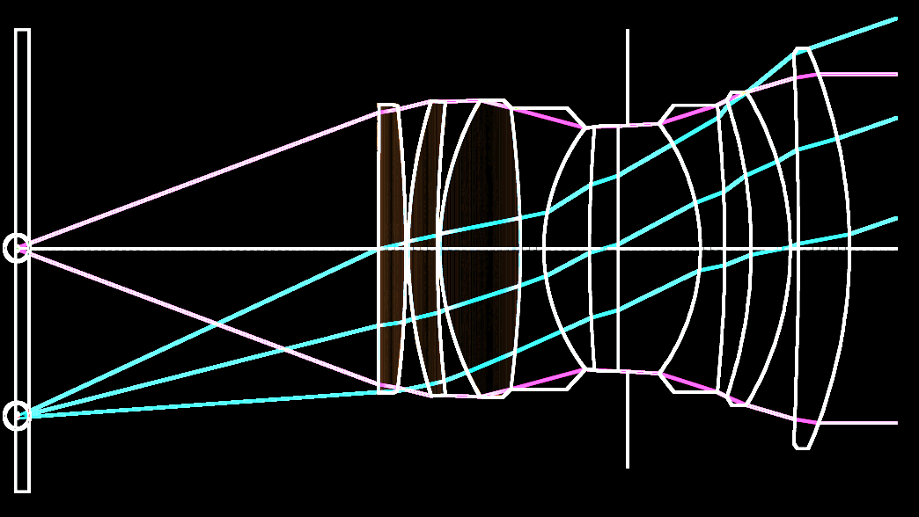
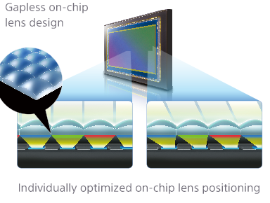
This ( ) is a Well-Known Property
Large chief-ray-angle in wide-angle cameras
Vignetting, crosstalk…
Solution: Microlens shift
[Leica M8]
[Sony a7R]
Notes:
Key message: Solution to angular variation
The solution in the conventional camera is to “shift” the microlens relative to the sensor.
In some sense, this is equivalent to rotate the angular sensitivity function to align with the direction of incoming rays.
So, this is a real and important property of the photosensor. However, it has been ignored in many previous study about the light field camera.
Our framework considers this parameter, and result in a more accurate model.
Note: useful links:
https://www.lumerical.com/tcad-products/fdtd/applications/cmos_image_sensor_pixel_microlens.html
http://www.dpreview.com/reviews/LeicaM8
http://www.amazon.com/Sony-Full-Frame-Interchangeable-Digital-Camera/dp/B00FRDUZUK/
http://docs.lumerical.com/en/cmos_microlens_shift.html
http://blog.teledynedalsa.com/2012/05/the-angle-on-optical-acceptance/

Slide 43
Surface
Old prefilter model
Depth-independent
Spatially-invariant
Match the lenslet density
Depth
Lenslet diameter
Notes:
Key message: Old model
So let’s come back to the old model. It’s depth-independent, spatially-invariant, and bandlimited.

Slide 44
Surface
Different designs + new model
Depth-dependent
Depth
[Ng 2006]
[Lumsdaine and Georgiev 2009]
Notes:
Key message: Design analysis based on new model
If we use our new model, the prefilter becomes very different. It is now depth-dependent.
Also, the shape of prefilter would change with the parameters.
For example, here we show two additional light field camera designs.
In those designs, the spacing between the sensor and lenslet are changed, and lead to different prefilter behavior.
The prefilter variation among those designs is actually much smaller than expected.

Slide 45
Surface
Different angular sensitivities
Depth-dependent
Not bandlimited
Depth
Notes:
Key message: Angular variation
Furthermore, if we adjust the angular sensitivity to make it more picky, the prefilter can become much weaker.
(Because in the real world the angular sensitivity function is never fully uniform, we believe this is the main source of non-bandlimitness)

Slide 46
Surface
Different photosensor locations
Depth-dependent
Not bandlimited
Spatially-variant
Depth
How to respect these properties in the processing?
Notes:
Key message: Photosensor location
Finally, we even find that even the relative location of the sensor element to the lenset can affect the prefilter.
In other words, the prefilter is actually spatially variant, even when the subject is at a constant depth.
(cont)
Now we have shown that the under-sampled light field can be aliasing free, and the real prefilter is usually non-bandlimited.
The next thing we are interested in is, how to reconstruct those details?
Here we are not inventing a new one, but like to review if existing methods can properly achieve that.

Slide 47
Light Field Reconstruction Methods
Depth-agnostic, mix signal globally
Sub-aperture image filtering [Wetzstein et al 2013, Cho et al 2013]
Frequency domain filtering [Ng 2005, Veeraraghavan et al 2007, Levin and Durand 2010, Dansereau et al 2015]
Depth-aware, process signal locally
Projection [Kitamura et al. 2004; Chan et al. 2007; Perez Nava and Luke 2009; Georgiev et al. 2011]
Deconvolution [Bishop and Favaro 2012; Shroff and Berkner 2013; Broxton et al. 2013]
Notes:
Key message: Existing methods
Reconstructing images from light field is a very popular research topic, and many algorithms have been proposed.
The most trivial methods arrange light field into an array of sub-images and then filter them.
We can also convert the light field to the frequency domain.
(click) However, we find these methods do not work well, because they ignore the depth information, and usually mix the signal globally.
On the other hand, we find two other kind of algorithms, the projection method and the deconvolution method, can properly reconstruct the images in a depth-dependent fashion.
They both process the signal locally, and respect the per-pixel depth information.
Due to the time limit, I only will briefly describe how our framework can analyze the projection method.
You can find more analysis about the deconvolution in the paper.

Slide 48
Projection
Move samples back to the surface (splatting)
Notes:
Key message: Animation for projection method
The idea of projection method is very simple. We first move the light field samples back to their origins on the surface.

Slide 49
Projection
Move samples back to the surface (splatting)
Density estimation around the view ray (gathering)
Notes:
Key message: Animation for projection method
Then, for each view rays from the sensor, we intersect it with the surface and perform density estimation around the intersection point.

Slide 50
True Resolution Limits
Optics/Scene
Prefilter profile
On-surface sample distribution
Software
Density estimation kernel
Lenslet density
Notes:
Key message: application of projection
Therefore, we believe it can be considered as the true resolution bound of the light field camera.
The achievable resolution only depends on 3 factors:
The strength, or bandwidth of the prefilter, the density of the projected samples, and the shape of the density estimation kernel.
Notice that it does NOT depend on the density of the lenslet at all.

Slide 51
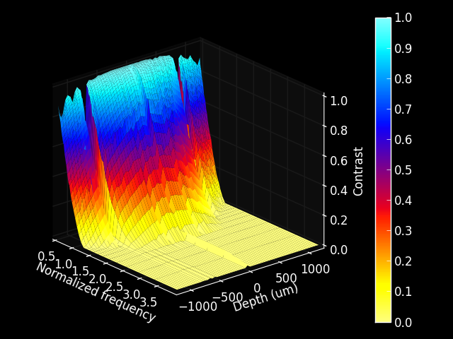
Source texture (> lenslet density)
Strong prefilter
Depth
Weak prefilter Uniform sample distribution
Bad sample distribution

Slide 52
High Resolution at Low Cost
30+ FPS by GL_POINTS with simple shaders
Sub-Aperture Image Filtering #lenslet
Projection
9x #lenslet
Notes:
Key message: projection is cheap
This method is very cheap. Actually, you can easily combine them into a single pass in openGL with simple shader, and achieve real-time performance.
The resolution chart rendering shown earlier is generated this way, and here I show one more result.
The image shown on the left is the result from the sup-aperture filtering method, and the one shown on the right is by the projection method.
You can see clear reconstruction of the skin details, eyelashes, or even blood vein in the eye.

Slide 53
Future
General model
Aberration, wave optics, resolution-noise tradeoff, image prior…
What is the “on-surface” angular resolution?
Impact to applications
Depth sensing, matting, compression
Accurate calibration
Full 4D sensitivity profile of the photosensor
Notes:
Key message: Future
Look into the future, there are more to be done.
We like to construct a more general model. We like to include more parameters or more properties of the optical elements. We like to analyze the tradeoff between the noise and the resolution, or how the nature image prior can affect the processing.
Also, besides the image resolution, how these properties would affect other applications or algorithms? How we estimate the depth from non-bandlimited light field?
The large amount of parameters in the light transport analysis also indicates that an accurate calibration to the real device can be very important. For example, can we easily measure the 4D sensitivity function of the photosensor?
Since the lenslet resolution is not the limiting factor anymore, we like to improve other factors of the light field camera. In the next talk, Li-Yi and I will describe a particular one. The 4D sampling structure of the light field camera.
Finally, it would be interesting to see if the depth-agnostic methods can be refined to compete with projection or deconvolution.

Slide 54
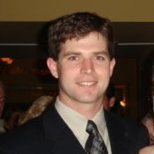
Thank You
Kurt Akeley
Ren Ng
Colvin Pitts
Lytro computational photography team
Anonymous reviewers
Notes:
Key message: Acknowledgement
I would like to thank many people for their help to this project.
Kurt, Ren, Colvin, and the Lytro computational photography team provide many ideas to the analysis, and the reviewers for their suggestions to the paper.

